Slide 1
Courses
Instructor-Led : The course syllabus and duration would be displayed while users will only register for the course on the website.
Self-Paced : All the contents would be online for the users to go through to complete the course
Users should be able to filter using cost (Free or paid) and mode (instructor-led or self-paced)

Slide 2
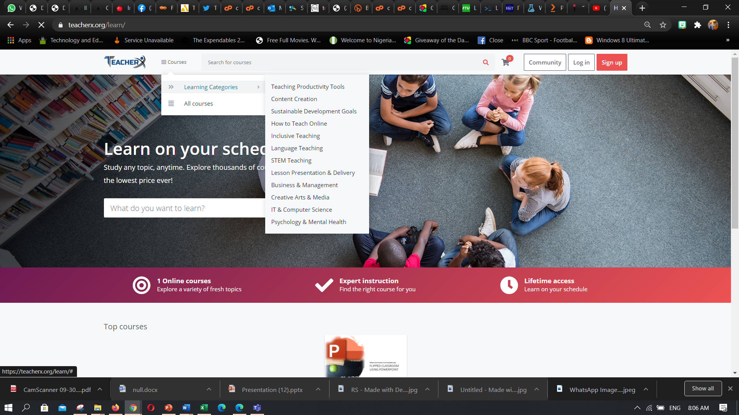

Slide 3
Check this out for self paced
https://teacherx.org/learn/home/course/flipping-lessons-with-microsoft-powerpoint/1

Slide 4
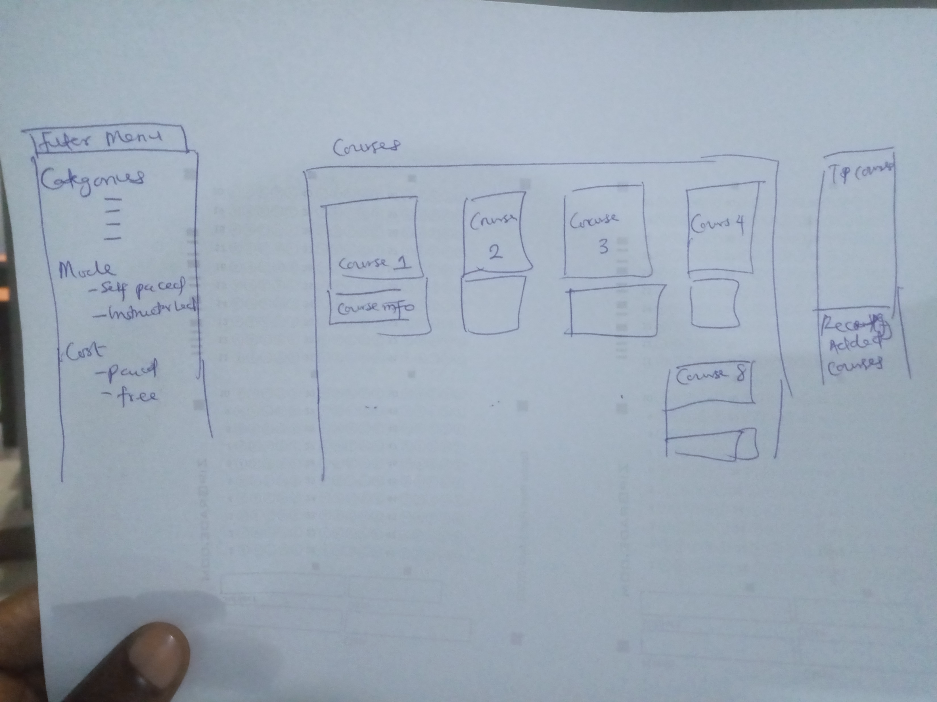

Slide 5
